Slide 1
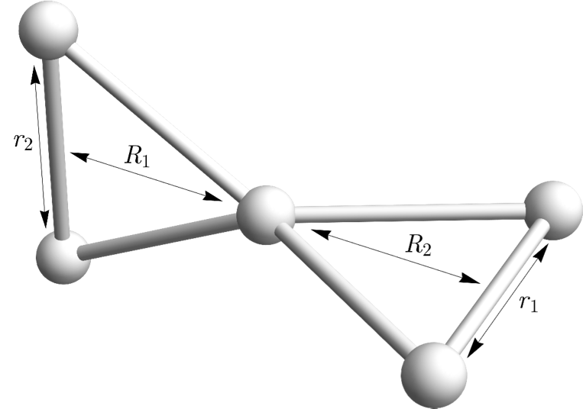

Slide 2
Results: Spectra
Green: Experiment
Blue: 2D Calculation
Red: 4D Calculation
Notes:
Labeled version on next page, but messy

Slide 3
Results: Spectra
Green: Experiment
Blue: 2D Calculation
Red: 4D Calculation
Note that there are H₅⁺ vibrations that do not correspond to the standard eigenstates
See the presenter notes for more info
Notes:
The Rxn notation basically means extending out into the H2 + H3+ <-> H5+ channel and not a standard H5+ mode. See slide 10 on the bottom left for an example of this kind of wavefunction.
Note that the peaks on either side of 4000 are basically the same modes but in different proportions.
I wasn’t sure how to label the surfaces, either, so I tried to group them with parentheses? Hopefully it’s somewhat clear
The 1 and 2 quanta vibrations don’t really have full quanta in the nu_A and nu_B of course. It’s some partial combo of both. I just labeled it like this though to show what it’s like

Slide 4
Future Directions
Expand calculation to larger grid – currently in progress; was hoping to just have Gaussian give me a bigger grid but will
Repeat calculation with parallel H₂ groups – Gaussian keeps crashing but hasn’t crashed on the current run yet so I’m hopeful
Get state assignments up to the 3 quanta region
Expand investigation of uncoupled/coupled adiabatic treatments?

Slide 5
Uncoupled Adiabatic Comparison
Purple: No Couplings
Red: With 1&2 coupled and 3,4, and 5 coupled
Note that some peaks appear only after coupling and that the frequencies/intensities generally modulate in the right direction

Slide 6
Transition moment surfaces
Analog to adiabatic potential surfaces
Allow for computation of intensities with just a shared proton wavefunction
Note the symmetries here dictate the symmetries of the intensity carrying wavefunctions
Notes:
Top of the triangle is the averaged over the ground adiabatic state, then the anti-symmetric and symmetric 1 quantum states (A and S in the following slides), then 2 A, A+S, and 2S

Slide 7
Results: Wavefunctions (1 Quantum H2)
Notes:
Top left for each wavefunction is the adiabatic state it’s built on. Top right is the assignment for that state as best I could discern.

Slide 8
Results: Wavefunctions (1 Quantum H2)

Slide 9
Results: Wavefunctions (1 Quantum H2)

Slide 11
Results: Wavefunctions (0 Quanta H2)

Slide 12
Results: Wavefunctions (0 Quanta H2)

Slide 13
Results: Wavefunctions (2 Quanta H2)

Slide 14

H₅⁺ Model
4D Model:
Antisymmetric shared H⁺ stretch
Symmetric shared H⁺ stretch
Two outer H₂ stretches

Slide 15
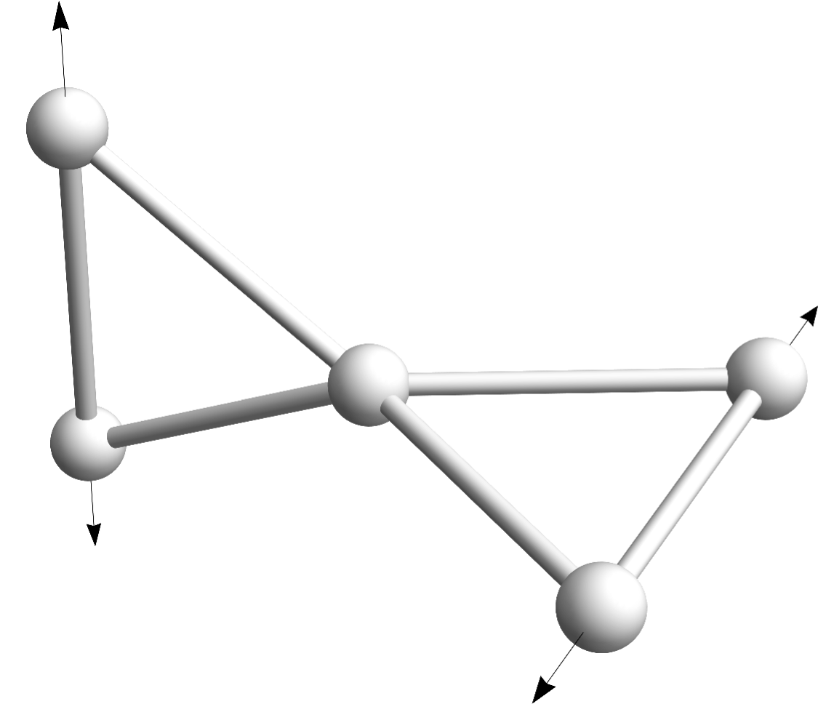
Outer H₂ Wavefunctions

Slide 16
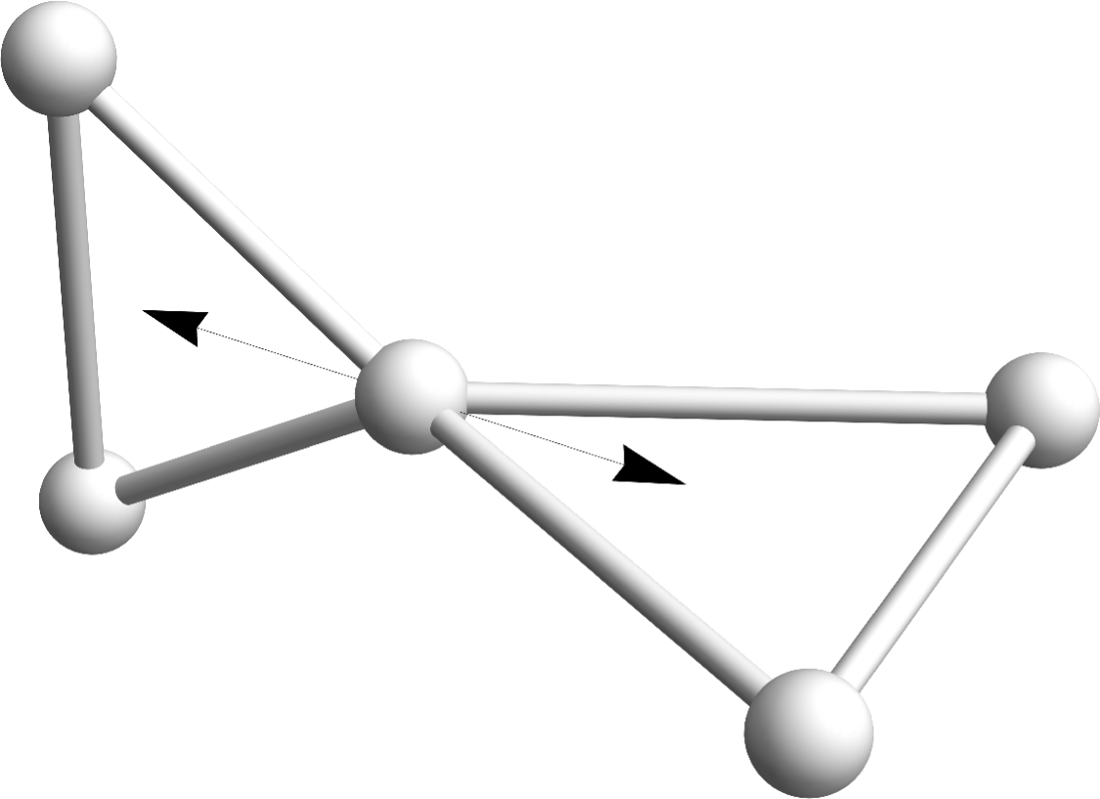
Shared Proton Wavefunctions

Slide 17
Adiabatic treatment
There is a separation of timescales
⇒ We can use an adiabatic treatment
Notes:
Reduce the 4D problem to a 2D problem by averaging over an H₂ wave function parametrized in the shared-proton coordinates.

Slide 18
Adiabatic treatment

Slide 19
Adiabatic Treatment
Notes:
Clearly get packets of states. Point out the yellow and green which might be hard to see. Make bold? Lol. Need to change red to yellow or something… I’m dumb.

Slide 20
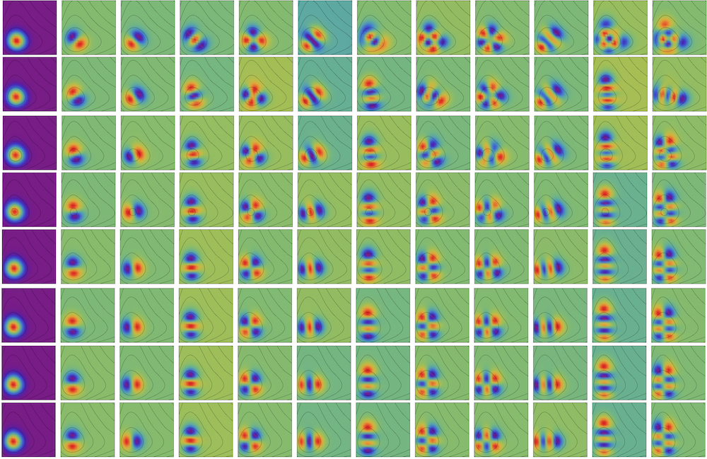
Outer H2 Wavefunctions
Each row is for a new a value
Each column is an excited state
These wavefunctions / energies are used to build the adiabatic approx

Slide 21



The Group and the Money People

